Slide 1
Portfolio Example
Your name
Your class(beginner/intermediate…)
semester

Slide 2
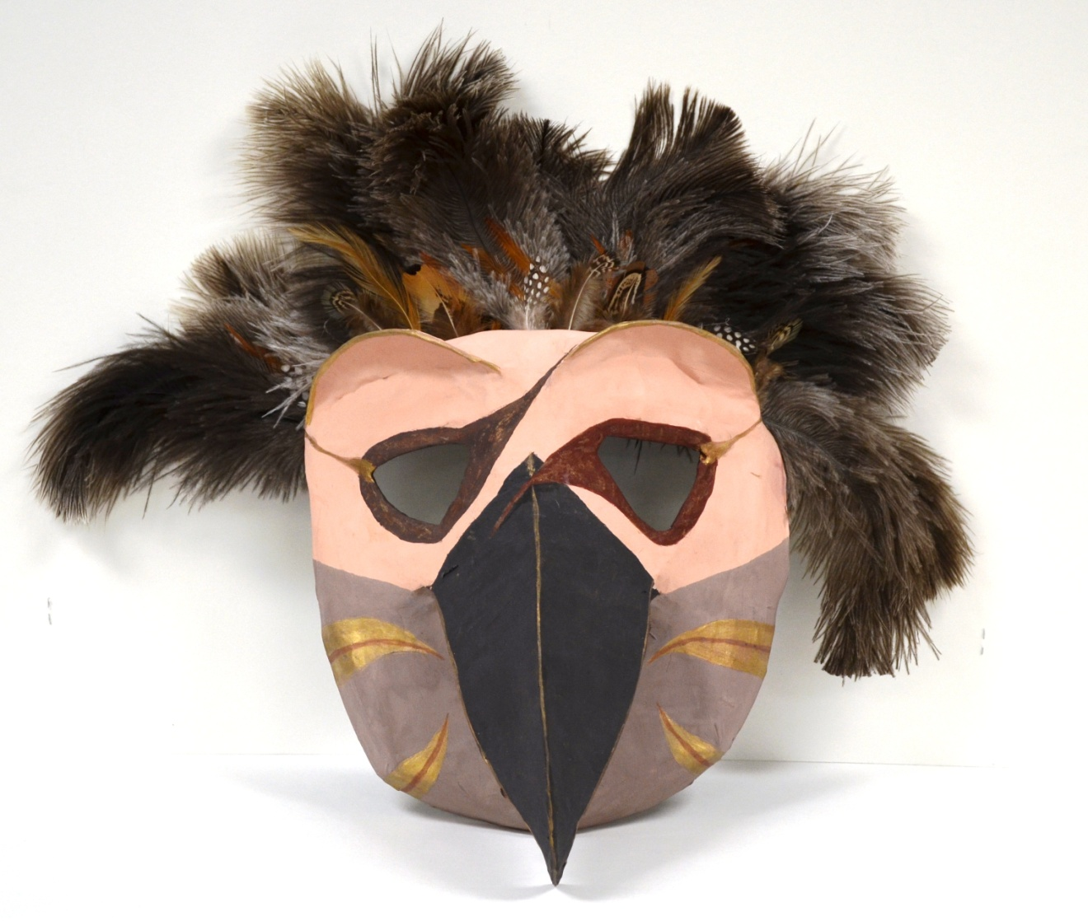
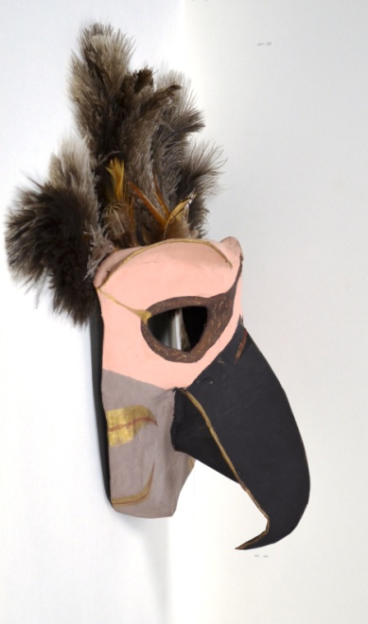
Bird Mask
Neutral color scheme of warm and cool browns and deep red with gold accents around the rims of the eyebrows and beak. I wanted to create a really fluffy texture so I found a feather duster and repurposed the feathers along the top of the mask.
I created emphasis on the beak by creating a very sharp menacing angle at the tip. I chose to exaggerate the beak and plumage. I created unity by using all neutral muted colors.
I based the design on the masks of the North West Coast Native Americans, and a picture of an eagle that I found in, “Animals:1419 Copyright-Free Illustrations”.
I am pleased with my design and think that it is a successful piece. If I had more time, I would have added more small textural surface pattern on the cheeks and around the eyes.
Bird mask made from Paper Mache, recycled materials, poster board, paint, and feathers. 8”x8”x6”

Slide 3
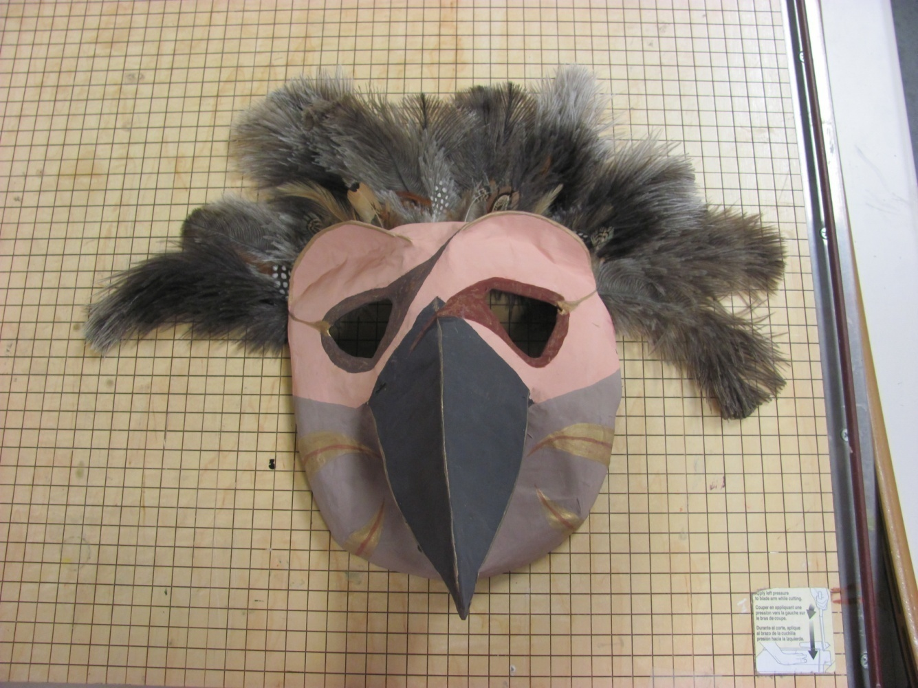
Bird mask
I like my mask because the feathers are really soft. I chose it because it has balance and emphasis. The colors create variety. It is 3D.
WHAT IS WRONG WITH THIS SLIDE?
Distracting background in image
Does not address description criteria.
Does not address analysis criteria.
Does not address interpretation criteria.
Does not address evaluation criteria.
The information given is not actually informative or coherent.

Slide 4
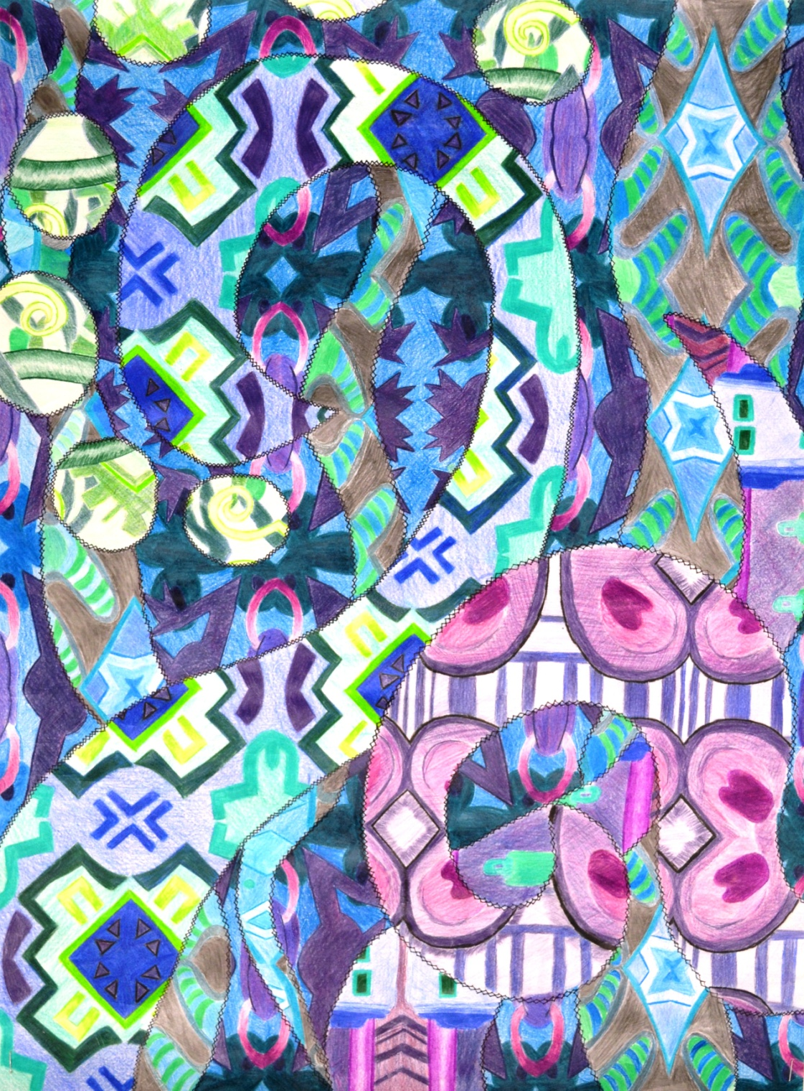
Quilt Inspired 2-D Design
Paper, colored pencils
18”x24”
Inspired by the Quilters of Gee’s Bend, I used a view finder to crop patterns from textiles and coloring books.
My overall layout consists of overlapping swirls with different fabric patterns within each.
I chose a cool color scheme to unify the composition, using a variety of blues, greens, and violets in each pattern. Although I used the same colors in most of the patterns I alternated the dominant color in each to separate the patterns.
From a distance this did not work as well as I would have liked it is hard to see the individual patterns until you look closely. If I were to do this project over I would create more differentiation among the patterns perhaps by varying the value among the patterns.

Slide 5
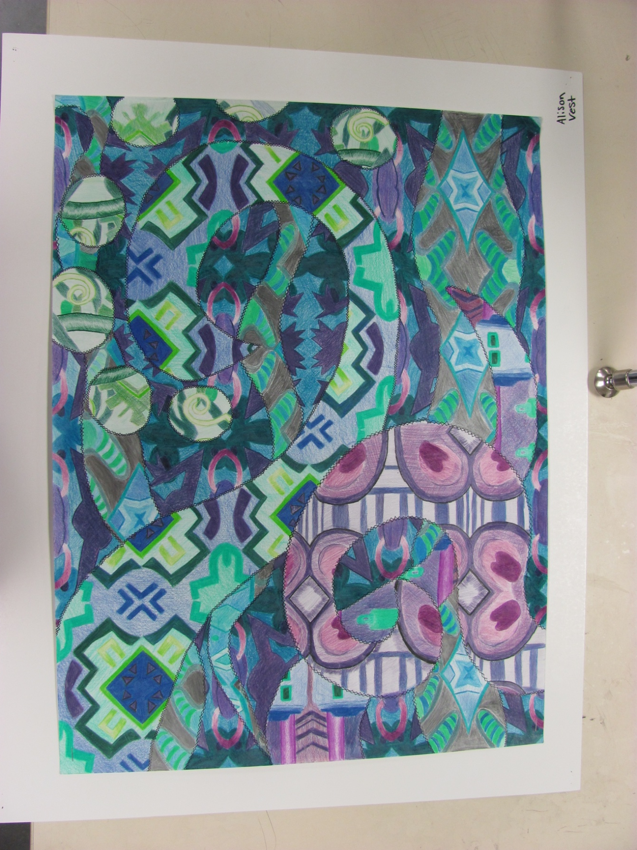
Paper quilt
My pattern is swirls and dots. I used all dark colors. Greens and blues and purples. It took a really long time to make.
WHAT IS WRONG WITH THIS SLIDE?
Distracting background in image
Image is tilted
Image is not exposed properly.
Does not address description criteria.
Does not address analysis criteria.
Does not address interpretation criteria.
Does not address evaluation criteria.
The information given is not actually informative or coherent.

Slide 6
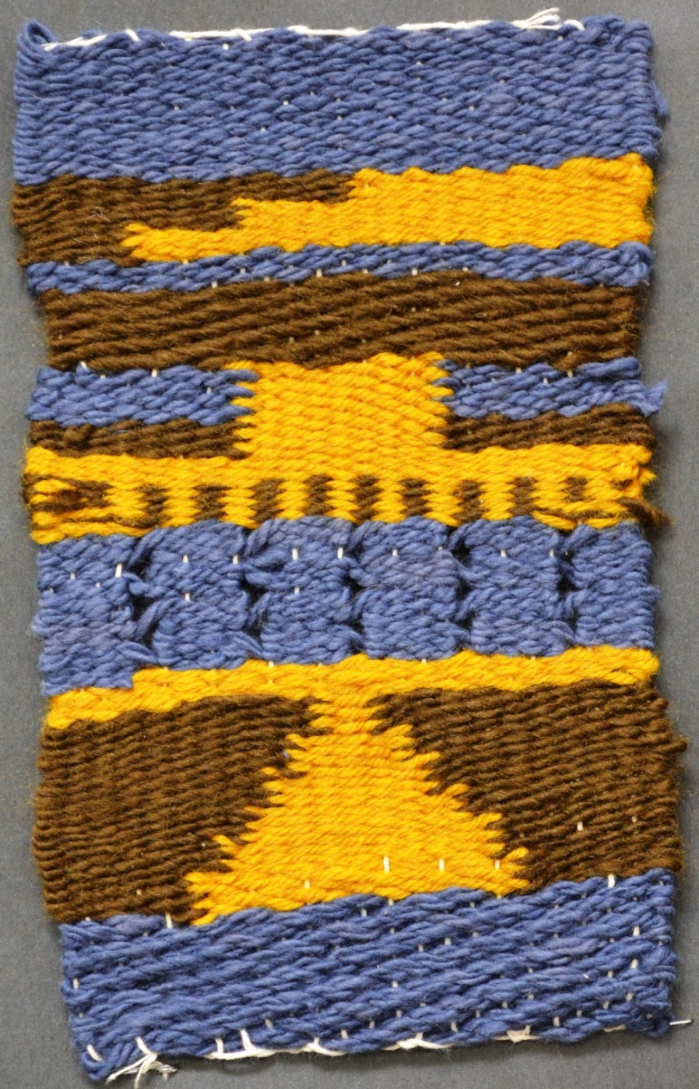
Weaving
Blue, brown, and golden yellow yarn
For my weaving I implemented the twill weave in a bold blue band across the bottom of my composition. I created a symmetrical triangle using tabby weave by dovetailing the brown and golden yellow yarns. Above that I created a pattern of Spanish lace repeating the blue that I used at the bottom. I then created vertical stripes by weaving with two yarns, alternating a golden yellow row with a brown row. I extended the golden yellow and created stripes to the side by dovetailing again. I then created a horizontal stripe of brown using the basket weave pattern. Up to this point my composition had been symmetrical but I wanted to create some movement so I dovetailed yellow and brown to create a stair-step line moving to the right. I finished my composition by repeating the blue bar from the bottom for unity.
I like my overall composition. However, I am glad that I do not have to weave fabric to create cloth for clothing and household goods. It was a very tedious process.

Slide 7
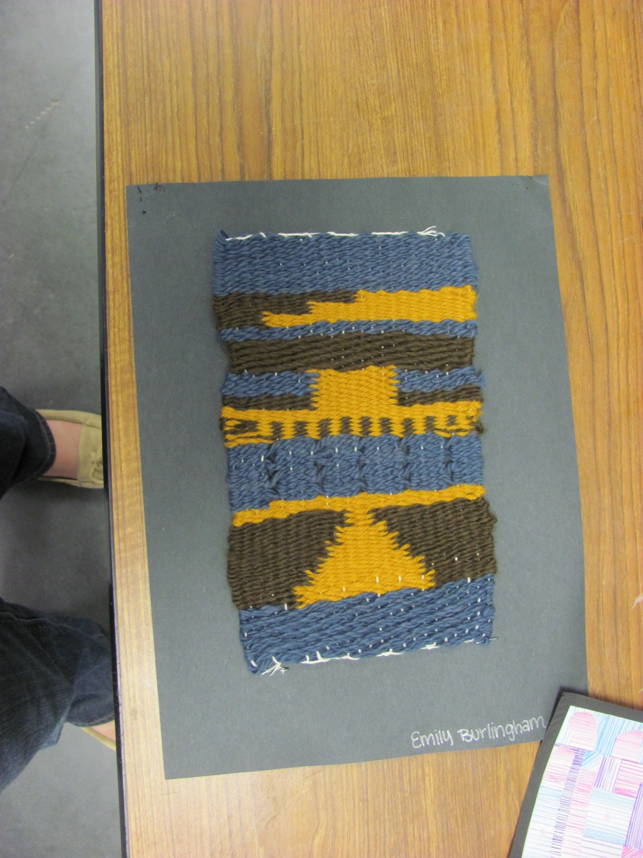
Weaving
I did tabby, basket, twill, brooks bouquet, dovetail, and slots. It has texture. I made it on a loom.
WHAT IS WRONG WITH THIS SLIDE?
Distracting background in image
Image is not exposed properly.
Image has a glare
Does not address description criteria.
Does not address analysis criteria.
Does not address interpretation criteria.
Does not address evaluation criteria.
The information given is not actually informative or coherent.

Slide 8
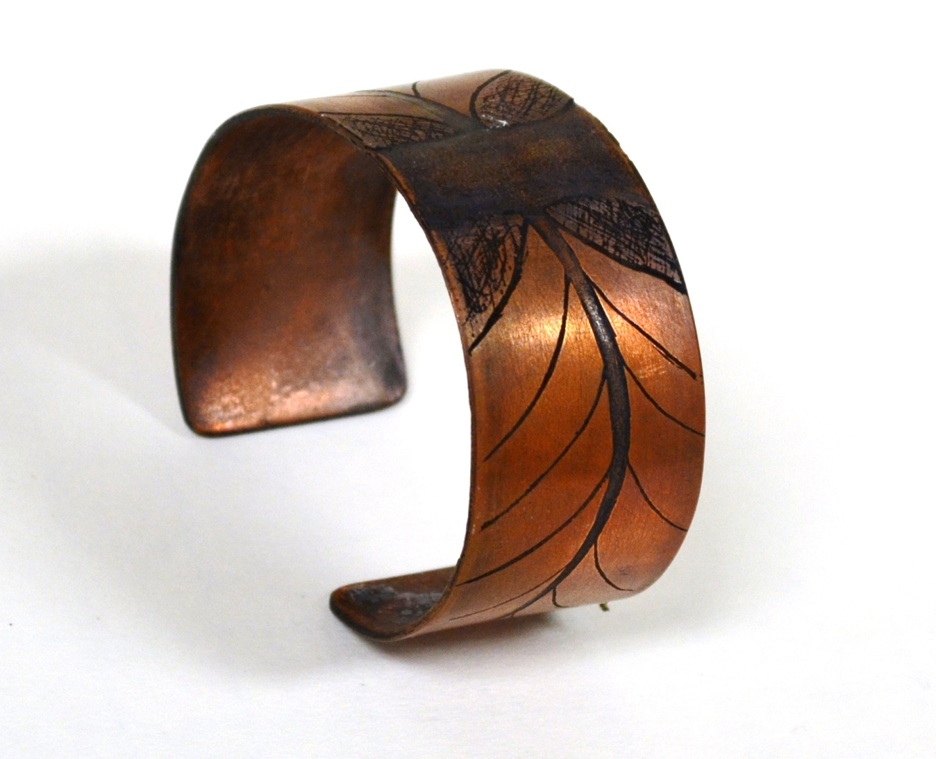
Etched copper bangle
Copper
3.5”x1.5”x4”
I created my design for this bracelet by abstracting a drawing of a guitar. I focused on the strings and frets. I began by filing and beveling a flat sheet of 1.5”x6” 16 gage copper. I then smoothed the edges by using progressively finer grit sandpaper. I washed my piece to remove any surface residue and dirt. I then carefully applied my pattern using a sharpie as a resist. The acid that we used was a mixture of 2 parts hydrogen peroxide and 1 part muriatic acid. I submerged my sheet of copper in the acid until it etched away the negative space around my resist. Then I put my copper in baking soda mixed with water to neutralize the acid. To bend the copper I first had to anneal it the enameling kiln to soften the metal. Once I had done this I bent the copper around a steel mandrel. I decided to use a liver of sulfur patina to create contrast between the positive and negative space in my design. Finally I polished the surface with a polishing pad.

Slide 9
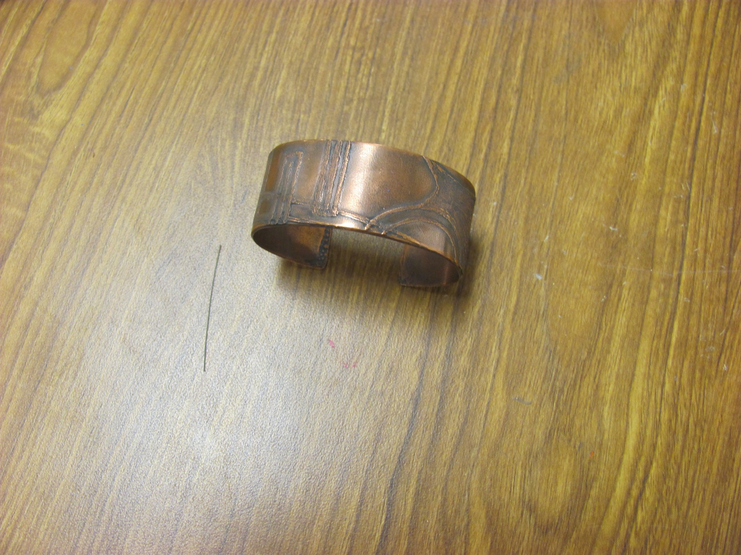
Etched bracelet
I etched the copper with pool acid. And put black stuff on it to make the pattern show up. I heated it up to make it soft so I could bend it.
WHAT IS WRONG WITH THIS SLIDE?
Distracting background in image
Image is not exposed properly.
Image has a glare
Does not address description criteria.
Does not address analysis criteria.
Does not address interpretation criteria.
Does not address evaluation criteria.
The information given is not actually informative or coherent.

