Slide 1
Sculpture
Shaping Space

Slide 2
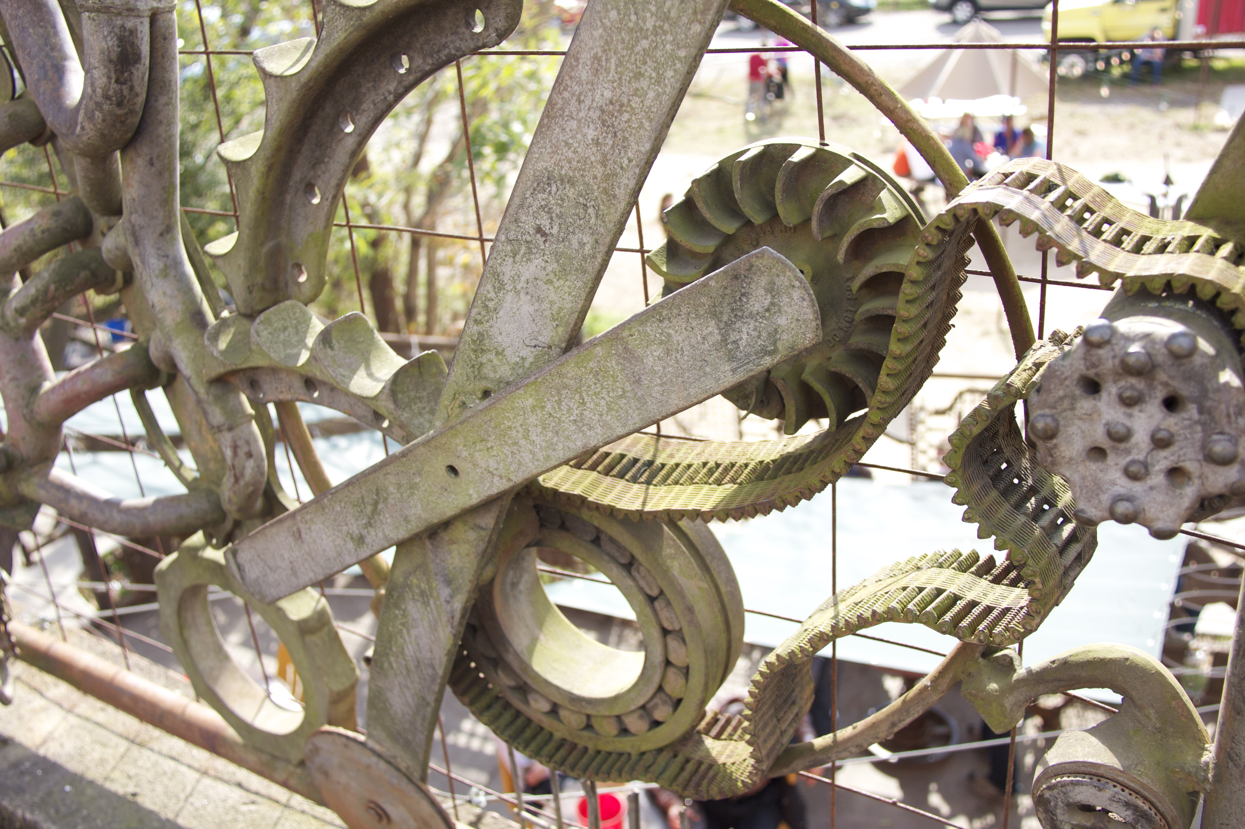
Fence in Asheville, NC

Slide 3
What is Sculpture?
How the artist shapes space…
A branch of the visual arts that operates in three dimensions.
Sculptural processes originally used carving (the removal of material) and modeling (the addition of material, as clay), in stone, metal, ceramics, wood and other materials but, since modernism, shifts in sculptural process led to an almost complete freedom of materials and process.
A wide variety of materials may be worked by removal such as carving, assembled by welding, modeling, molded, or cast.

Slide 4
Sculptures Purpose
Functional vs.
Non- Functional
Sculpture is created to serve a usable purpose.
Examples include (not limited to…):
dinnerware
furniture
homes
jewelry
masks
tiles
vases
Sculpture is created purely for aesthetic purposes. * Made to look at.
Examples include (not limited to…):
wall hangings
garden sculptures
installations
outdoor monuments
figurines/ figure

Slide 5
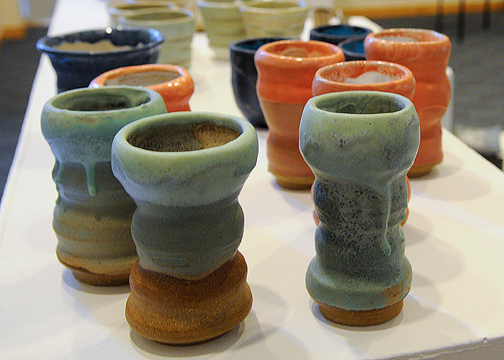
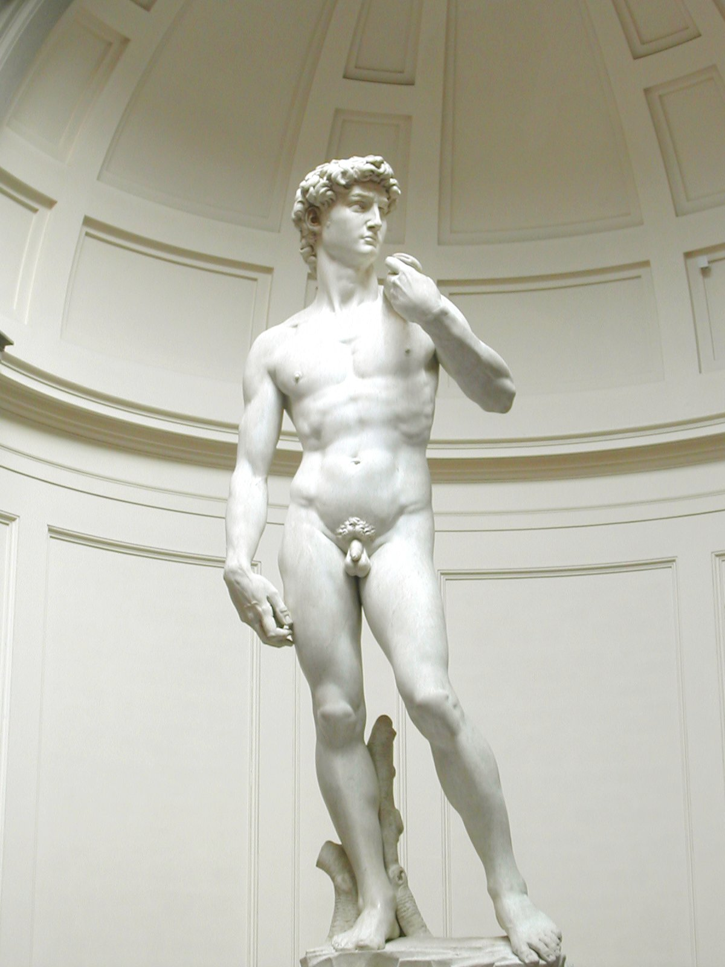
Functional
Student Mugs
Non- Functional
Michelangelo's David

Slide 6
Material and Size
Sculptor’s choice of material usually determines the size and scale of their work. For Example:
Silver-smithing and jewelry making materials are very expensive so most jewelers tend work on a small scale.
Ceramic artists are limited to the size of their kiln. They may only make art work that can fit into their kiln to be fired. Or their work may be made in several pieces and then assembled together.
Wood is a fairly cheep material and artists are only limited to their imagination as far as size and scale.
Many artists are using only recycled materials as the cost of consumable goods rise (you name it and someone has probably made a piece of art out of it) and again size limited to imagination.

Slide 7
Volume and Mass
Volume is the defining characteristic of a sculpted work. The size and shape of a form give the sense of volume because it can be viewed from all sides.
A simple form, such as an egg or pebble is a single three dimensional shape. This shape is a mass that has it’s own volume.
More complex forms such as a human figure have several masses that make up the form. The whole figure can be regarded as several masses of differing volumes.

Slide 8
Planes
A plane is two dimensional
It can be the flat front of a box, the triangular side of a pyramid, or the curved plane of a cheek or forehead on a portrait.
Before starting a sculpture it is sensible to visualize the form in terms of the major planes that will make up the sculpture from all sides.

Slide 9
Line & Surface
Line is used to create a sense of movement or shape.
It is also important for armatures (like a skeleton underneath a type of media), if you don’t have the right structure your sculpture will not look correct.
The surface of a sculpture will ultimately define the character of the final piece.

Slide 10
What to Make…
Remember art is visual communication.
What are you trying to communicate through your art ?

Slide 11
What is that?
Representational
Non- Representational
Are you trying to make your sculpture look like something from real life ?
If so many sketches and studies are required to ensure that your subject remains true to form and detail.
Are you trying to make your sculpture more expressive (look like a feeling)?
Are you not basing your sculpture off of anything in real life?
If so you will still need to do sketches to plan out your work before hand but more attention to the elements and principles of design will be important to make your sculpture successful.

Slide 12
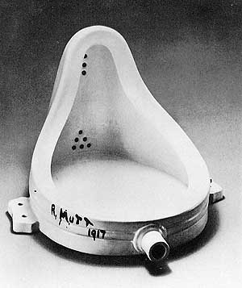
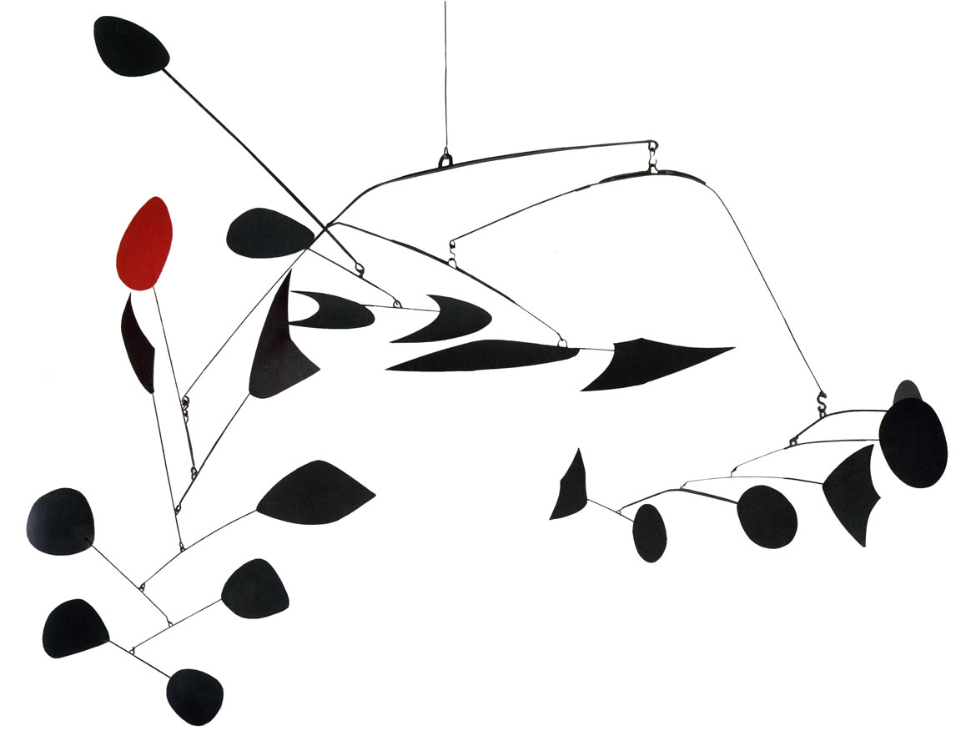
Representational
Non- Representational
R. Mutt - Fountain
Alexander Calder - Mobile

Slide 13
Planning
Sketches are important to work out your idea before you start working in your material of choice, remember… materials are precious and you don’t want to waste them by continuously making bad art and having to start over again.
Maquette- sculptors often times make a small scale version of their sculpture in modeling clay, paper, or other cheep material. This is a great way to practice making the form, but not spending too much time on it.

Slide 14
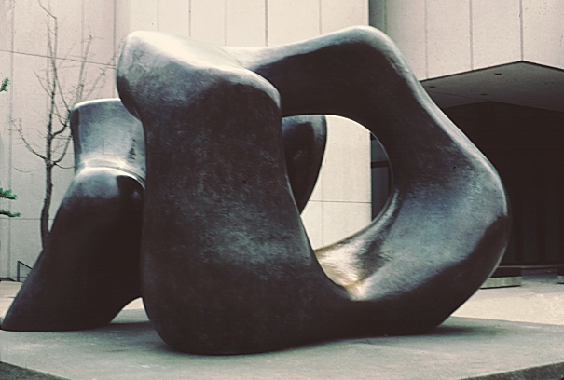
Henry Moore
Cast bronze 1974

Slide 15
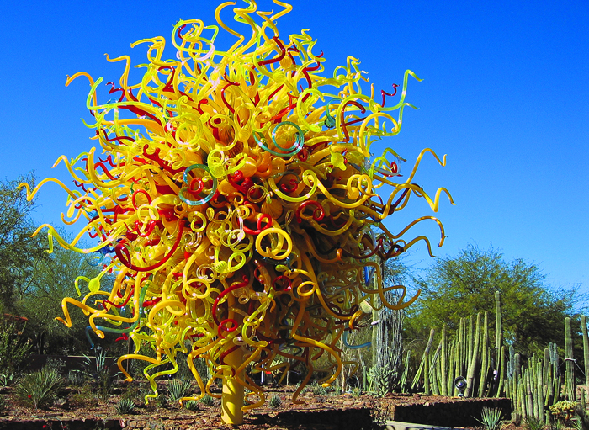
Dale Chihuly
Glass in Botanical Garden Phoenix, AZ

Slide 16

Origami Crane
Japanese Paper Folding

Slide 17
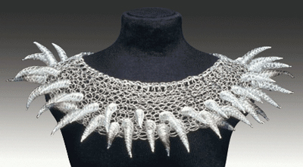
Arline Fisch
"Silver Anemone necklace"

Slide 18
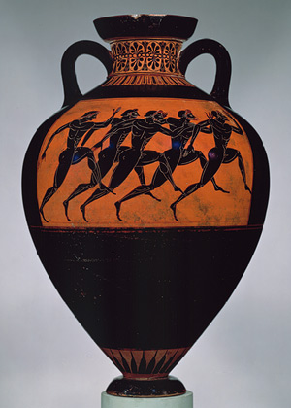
Greek Vase
Ceramic – 530 BC

Slide 19
Craft Vs. Fine Art
Craft
Fine Art
Traditionally artists were trained in guilds under a master artist in an apprenticeship.
Today the apprentice system is all but extinct and craft has another meaning.
Crafts today are generally considered to be at home projects or for young children.
Many crafts can be purchased in ready to make kits and are easy DIY projects.
Fine artists today are trained in universities in bachelor and master of arts programs.
Breaking into the “fine art” world is extremely difficult.
What is considered to be fine art is determined by a small number of people with years of training and expertise.
Fine art is displayed in museums and private collections typically with an admittance fee to public.

Slide 20
What will you make ?
Happy sculpting!

